Slide 1

Azure Landing Zones Workload Accelerators
Speaker
Title

Slide 2
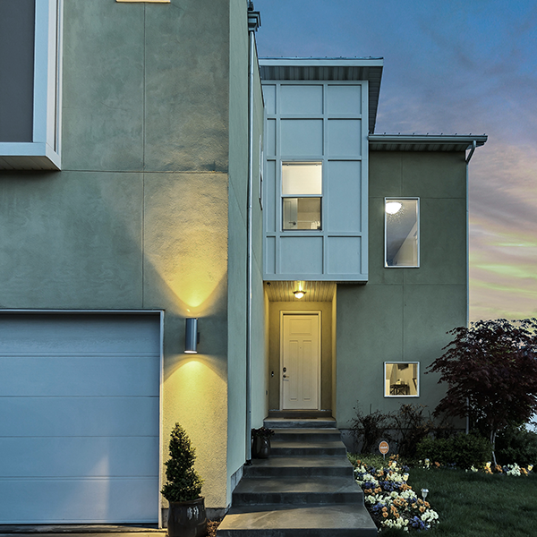
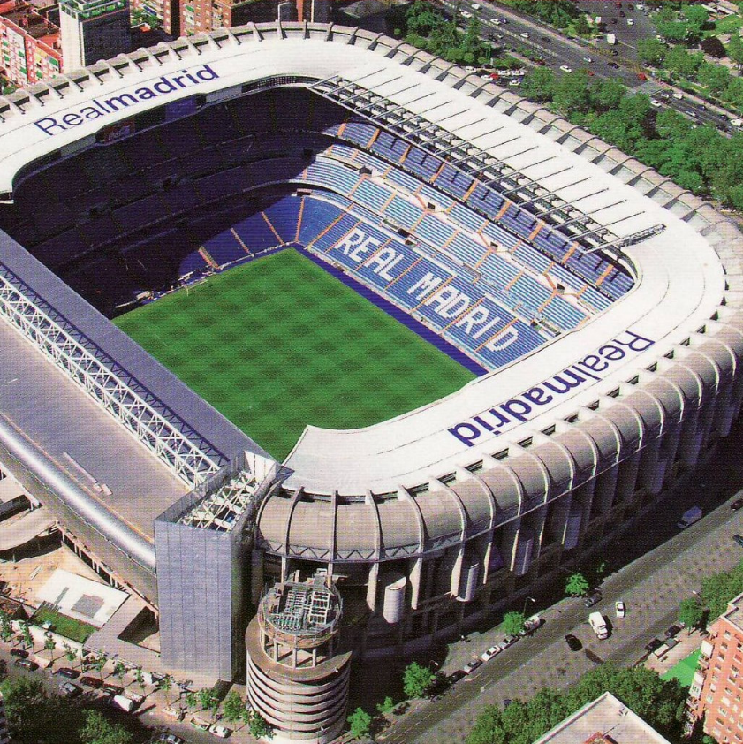

What are you building? Your cloud foundation supports the construction of a—
House
Stadium
Bridge
Notes:
Building a cloud environment like constructing a building—a house, stadium, or bridge.
The structure you’re going to build will determine your approach and architectural style.
Depending on the structure, the foundations may vary.
However, there will be common items across the various foundations.
This is also true in the cloud.
The cloud foundations may vary depending on your requirements, or the scale you need for your environment
but just like construction foundations will start with concrete and steel, cloud environments will also share common starting elements.
Which is where a landing zone comes. Let's look at what purpose they serve.

Slide 3
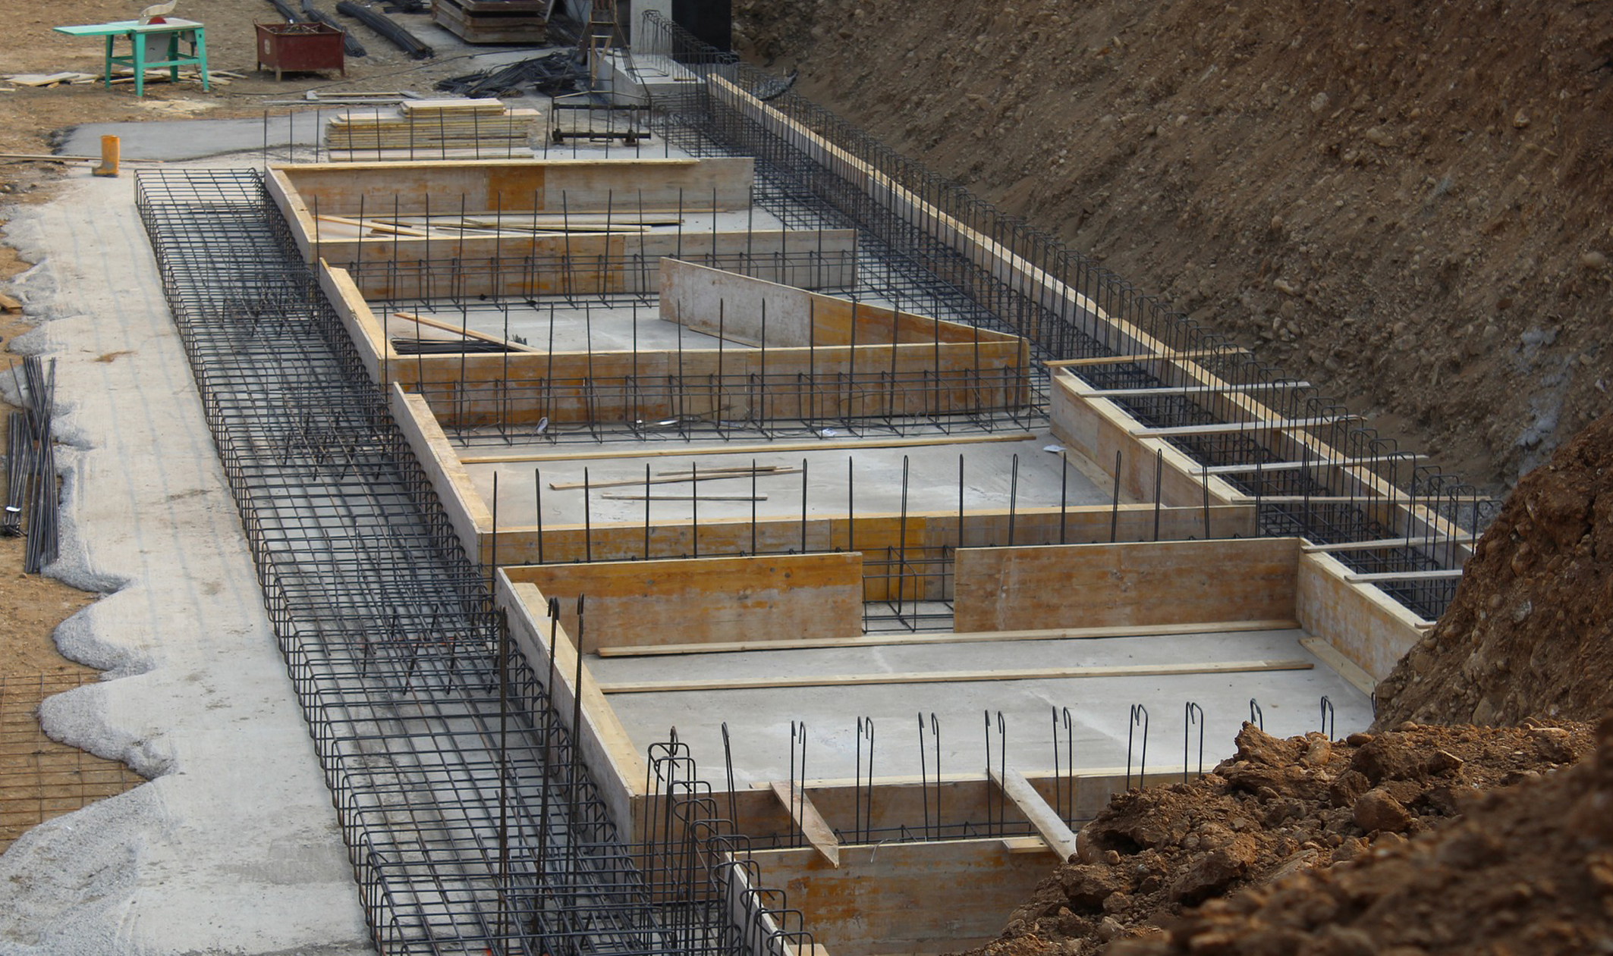
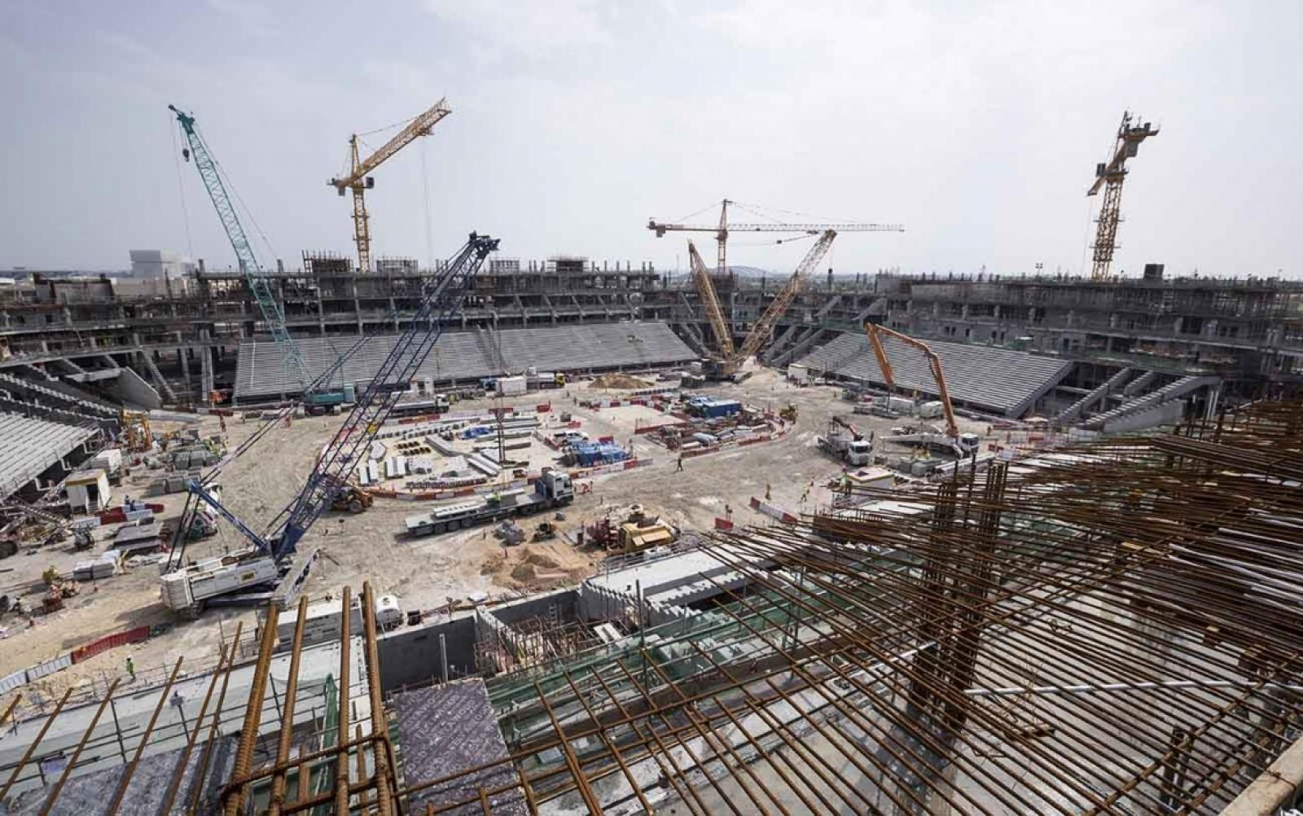
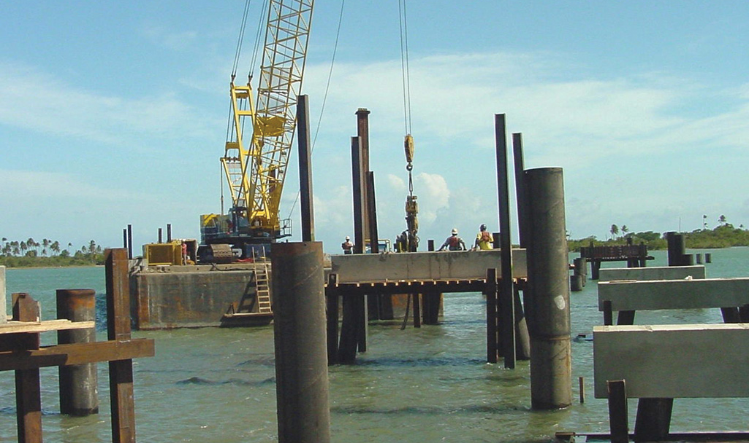
All foundations are NOT created equal
A house
A stadium
A bridge
Notes:
<Key point>: The foundation selection depends on what you’re building.
Foundations will be tailored to the construction of what’s being built above it.
<Transition>: Choosing the right structural foundation is like choosing the right cloud foundation.

Slide 4
What are landing zones for?
Starting a journey based on best practices with a start-to-finish plan is a key factor for success
Creating well-designed foundations for a cloud environment will enable the safe adoption of new technologies, at pace
Using consistent, repeatable environment designs helps scaling out in a manageable way
Baking in repeatable best practices into environment deployments
Factoring your team's technical skills into environment planning
Notes:
A landing zone is intended to help start an environment build from strong foundations.
Best practices
Repeatable to ensure standardization
Consider technical skills of the team and their learning plans as part of the decisions you take in planning your landing zone.
Let's look at the benefits landing zones can provide for your organization.

Slide 5
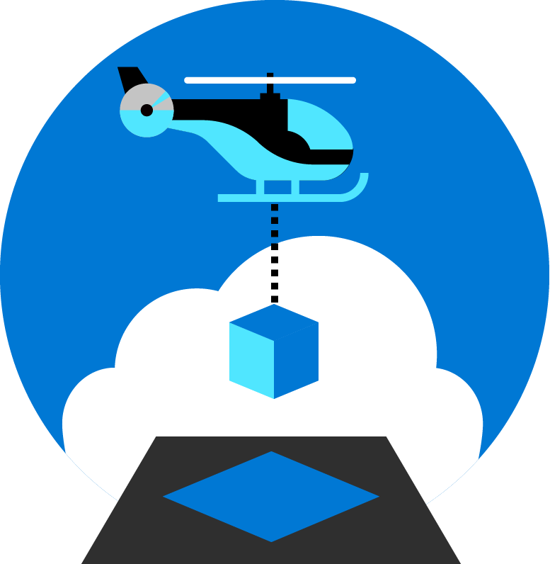
Azure landing zones
Set up Azure environments— for scale, security, governance, networking, and identity
Enable migrations and net new apps
Consider all platform resources
Don't differentiate between IaaS or PaaS
Notes:
Azure landing zones focus on unifying technologies and technical guidance to help you build a successful cloud environment.
In general, Azure landing zones:
Offer repeatable packaged environments
Enable migrations and net new apps.
Simplify the process of starting a cloud environment, to enable teams to focus on migration or innovation
Now, lets look in detail at what we consider to be the focus areas for a landing zone.

Slide 6

Azure landing zones Design areas
Azure billing & Azure Active Directory tenant
Security
Identity & access management
Governance
ENVIRONMENT
COMPLIANCE
Resource organization
Management
Network topology & connectivity
Platform automation & DevOps
Notes:
Design areas (the different parts that make up Azure landing zones) are an important early step in thinking about and designing a landing zone.
Azure billing an Active Directory tenant - Proper tenant creation, enrolment, and billing setup are important early steps.
Identity and access management - Identity and access management is a primary security boundary in the public cloud. It's the foundation for any secure and fully compliant architecture.
Resource organization - As cloud adoption scales, considerations for subscription design and management group hierarchy have an impact on governance, operations management, and adoption patterns.
Network topology and connectivity - Networking and connectivity decisions are an equally important foundational aspect of any cloud architecture.
Security - Implement controls and process to protect your cloud environments
Governance - Automate auditing and enforcement of governance policies.
Management - For stable, ongoing operations in the cloud, a management baseline is required to provide visibility, operations compliance, and protect and recover capabilities.
Platform automation and DevOps - Align the best tools and templates to deploy your landing zones and supporting resources.
Split into Environment and Compliance:
Build vs Run
Starting points vs on-going iterations and refinements
Let's look at how we approach an understanding of how a cloud operating model works.

Slide 7
What is Enterprise-scale?

Slide 8



Key Challenges
Architecture Complexity: Customers lack the required level of understanding and experience on Azure. The mismatch between on-premises infrastructure and cloud-design considerations creates dissonance and friction with respect to defining architectures and standards for their migration to the cloud. They are struggling with the translation of their requirements to Azure concepts, capabilities, constructs and security model.
Operating Compatibility: Existing approaches and functions for the traditional delivery and management of IT services are not compatible with the Azure platform and cloud operating models. When combined with a lack of skills and experience, customers are struggling to define and therefore transform their operating model to manage and support large-scale cloud infrastructure.
Lack of Trust and Desire for Control: The absence of a precise and detailed cloud architecture that is compliant with their requirements, and the lack of a well-defined operating model to support such a platform, leads IT not to trust Azure and instead strive to maintain full control. This often involves building ‘walls’ and complicated processes which ultimately get in the way of business lines adopting Azure.
Notes:
In working with our customers and partners we have received feedback from some of the challenges they face. When starting with Azure but being accustomed to Traditional IT Architecture the Cloud model can get lost in translation between Technology concepts, security models, and IT management processes. On top of the architectural challenges there are challenges with operating models. Traditional delivery and management of IT services is not compatible with cloud operating models. Lastly our Customers and partners have a desire for Control of their could environment and precise and compliant platform that generates trust.

Slide 9
Enterprise-scale?
Enterprise-scale is an architecture approach and reference implementation that enables effective construction and operationalization of landing zones on Azure, at scale and aligned with Azure Roadmap and Microsoft Cloud Adoption Framework for Azure.
Authoritative Provides holistic design decision framework for Azure Platform.
Proven
Based on success of large-scale migration projects at-scale.
Prescriptive Apply it on clearly plan and design your Azure environment.
Enterprise-scale Architecture:
Enterprise-scale design principles: Principles to help/guide you customize the design.
Enterprise-scale design guidelines: Guidelines (decisions and recommendations) for the 8 components of the enterprise-scale architecture
Enterprise-scale Implementation guide: The way you create those things using reference implementation in GitHub and the deployment pipeline
Enterprise-scale Reference Implementation:
Enterprise-scale foundation: A reference implementation of shared services containing network, security, identity, governance services required to construct and operationalize an enterprise-scale landing zone
Enterprise-scale landing zone(s): A reference implementation of a workload environment conforming to the enterprise-scale architecture (opinionated way to implement, code)
Notes:
Enterprise-scale comes in two buckets
The Architecture – What must be true? This is our Microsoft opinion on what should be done based on really world work with our strategic customers.
The reference implementation – This is a first partner example on how this could be implemented. You do not have to use this reference implementation if you are following the design guidelines and principles.
In the rest of the session, we’ll discuss these 5 elements.

Slide 10
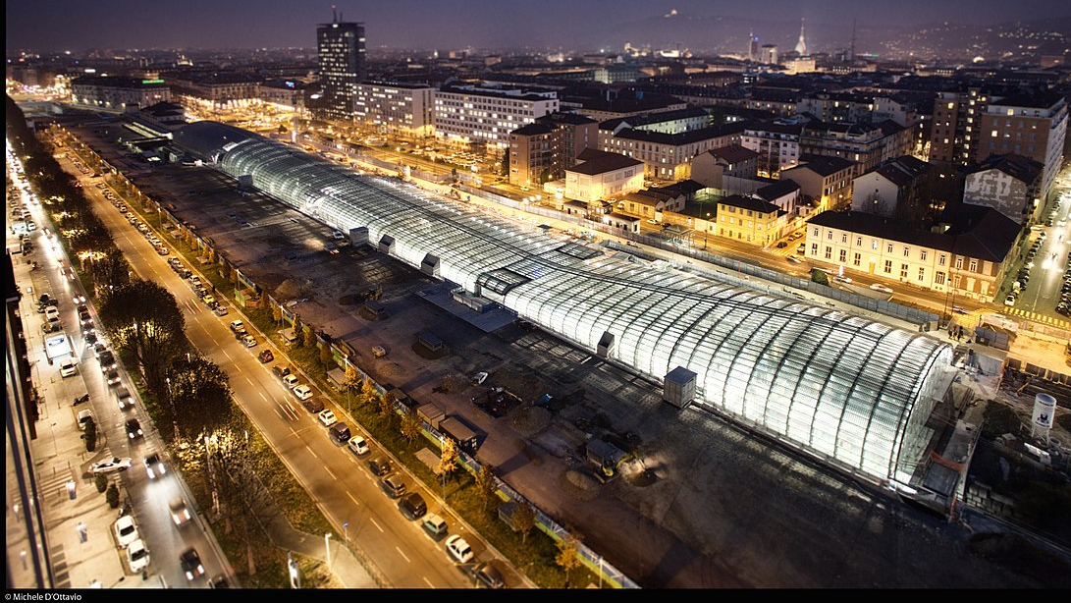
Metropolis
Using an analogy, this is similar to how city utilities such as water, gas, and electricity are accessible before new houses are constructed. In this context, the network, IAM, policies, management, and monitoring are shared 'utility' services that must be readily available to help streamline the application migration process.
Notes:
TALK TRACK:
One of the best analogies for understanding a landing zone, is to compare it to the necessary services upon which a city is built. Before buildings can be erected and people move into them essentials services must be in place. Road are necessary for people to move around, water and sewer facilities need to be in place, power and gas lines must be made available. You can think of a landing zone as the essential services required for the different types of applications you will host on Azure. Different applications may require different services, and guardrails, and therefore will live in different landing zones. Similar to zoning codes in real life.
One of the major shifts for a centralized IT organization in this scenario is to move from providing all the infrastructure (building for people to live in) to providing the zoning guides (guardrails to be in place for other business units to build their infrastructure and application upon).
One of the main benefit of the cloud is that you can scale resources based on demand and the there is practically no limit on scale. The same applies for scaling down. Just like you turn on light bulbs when you need it and turn it off when you do not , and you are charged only for the portion of electricity when the light bulb is turn on, you can turn on any VM, resources, IOT or any other resources when you need it and turn it off when you do not . Azure give you better option than turn on and off button, imagine a Dial on light bulb and keep adjusting for the light needed indoor during daytime or night when light keep changing because of sunlight or cloud. There is practically no capital cost associated with IT in the cloud because you are not buying hardware to build data center. You are using everything and anything on demand based on need.
Because of this power of unlimited scale, governance problem arises. Due to sheer number of resources, governance and organization of resources become challenge. After all we like to make our and other lives easier, so we think about solving this problem of governance.
I would like you Imagine a library with a pile of books with no marking and sorting and section and you have to find your particular book, it will be difficult, almost impossible.
The same applies to resources in Azure subscription if its not properly organized and not organized for operational efficiency.
Enterprise scale is the answer to organizing subscription to landing zone. We build landing zone so we would know where to go and provision resources when we need them. Just like in a library when we pick up a book , we know where to go to find it or to place it.
Landing zones help with the adoption of cloud and give you a better way of organizing resources not just its type, but by organization, cost and security.

Slide 11
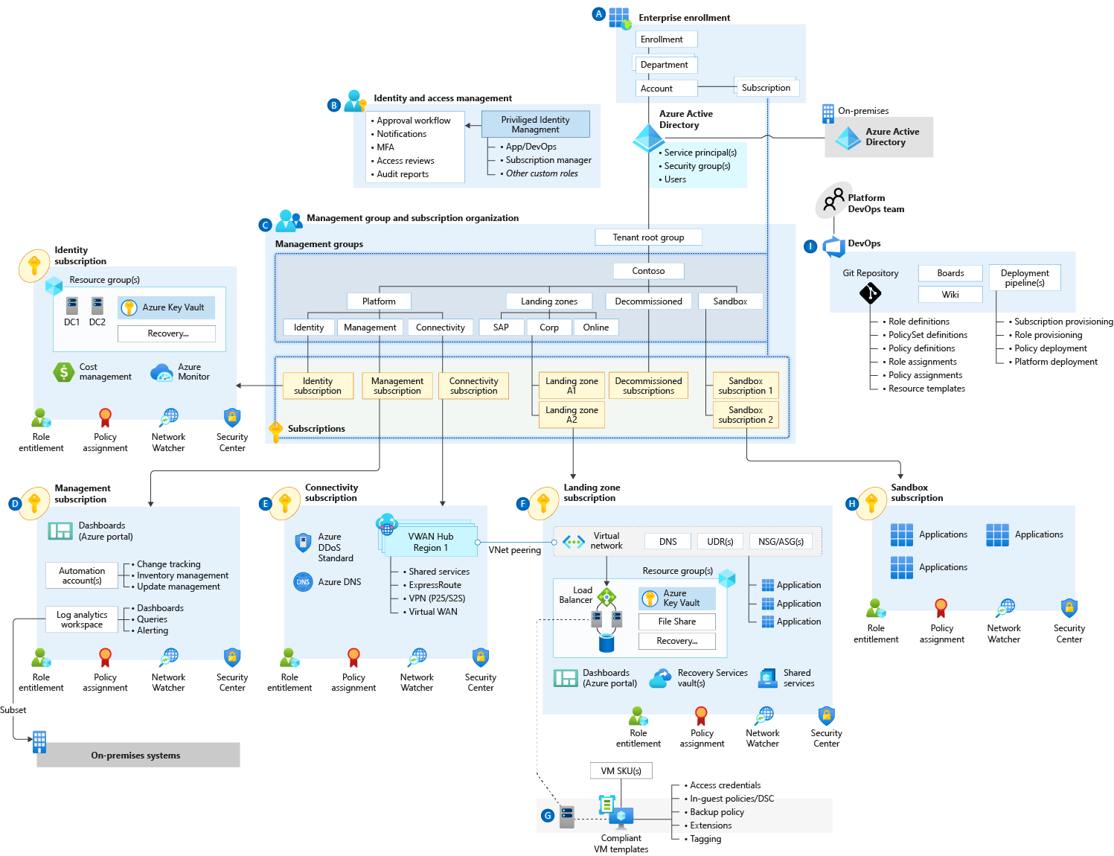
Enterprise-scale landing zone(s) The principle purpose of the “Landing Zone” is therefore to ensure that when an application or workload lands on Azure, the required “plumbing” is already in place, providing greater agility and compliance with enterprise security and governance requirements.
Notes:
The CAF enterprise-scale landing zone architecture represents the strategic design path and target technical state for the customer's Azure environment. It will continue to evolve in lockstep with the Azure platform and is ultimately defined by the various design decisions the customer organization must make to define their Azure journey.

Slide 12
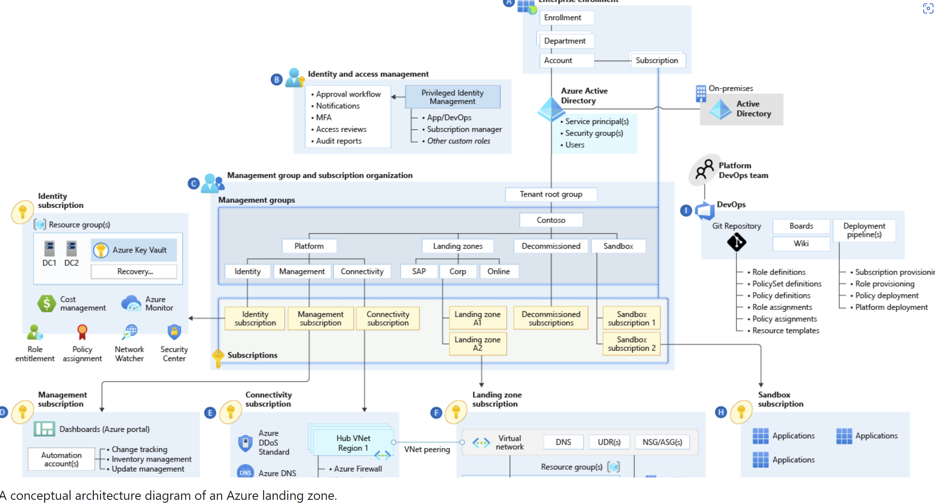
Azure landing zone conceptual architecture

Slide 13
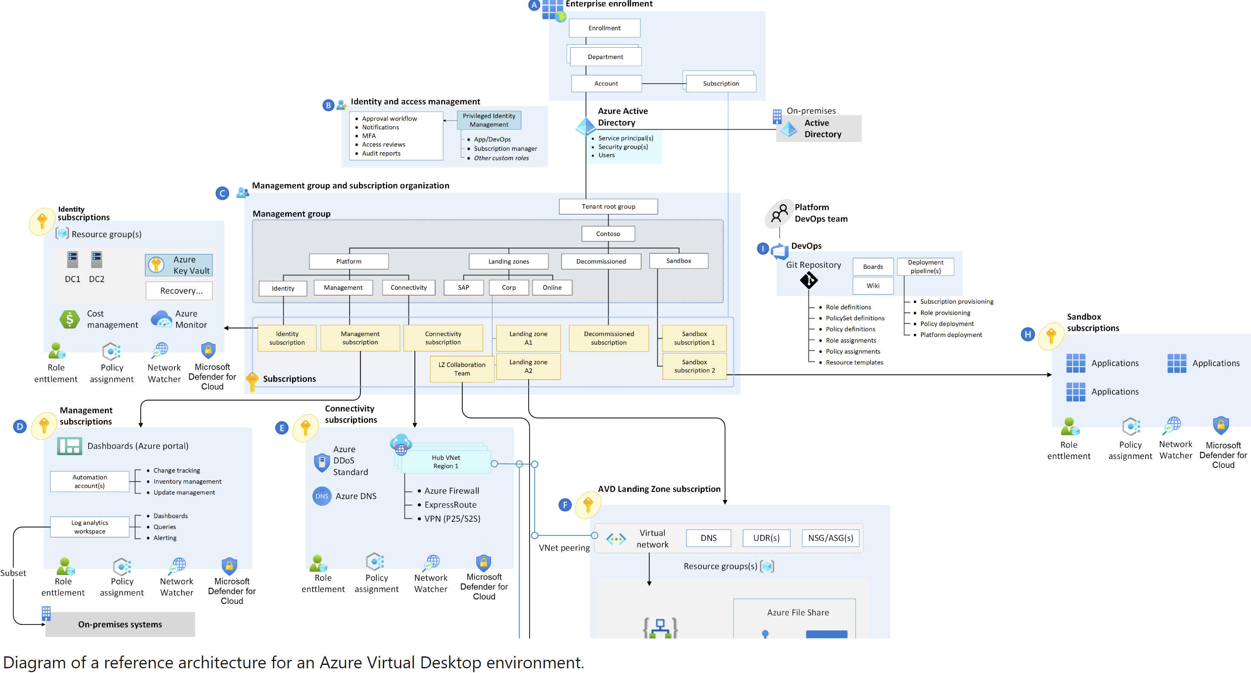
AVD Landing Zone Accelerator

Slide 14
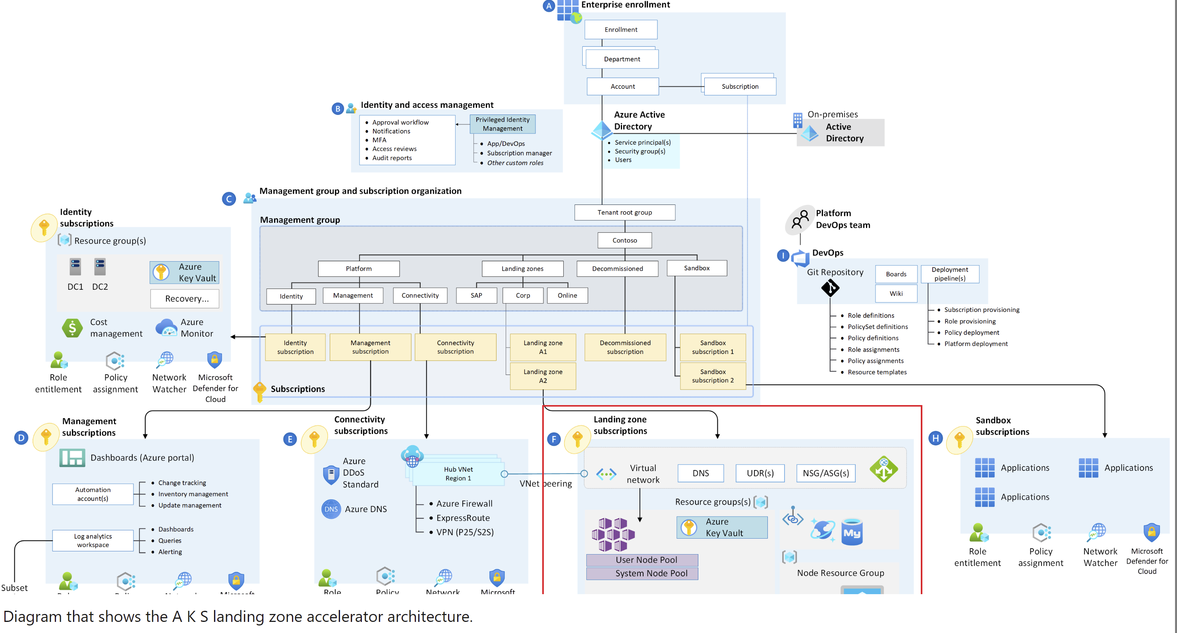
AKS Landing Zone Accelerator

Slide 15
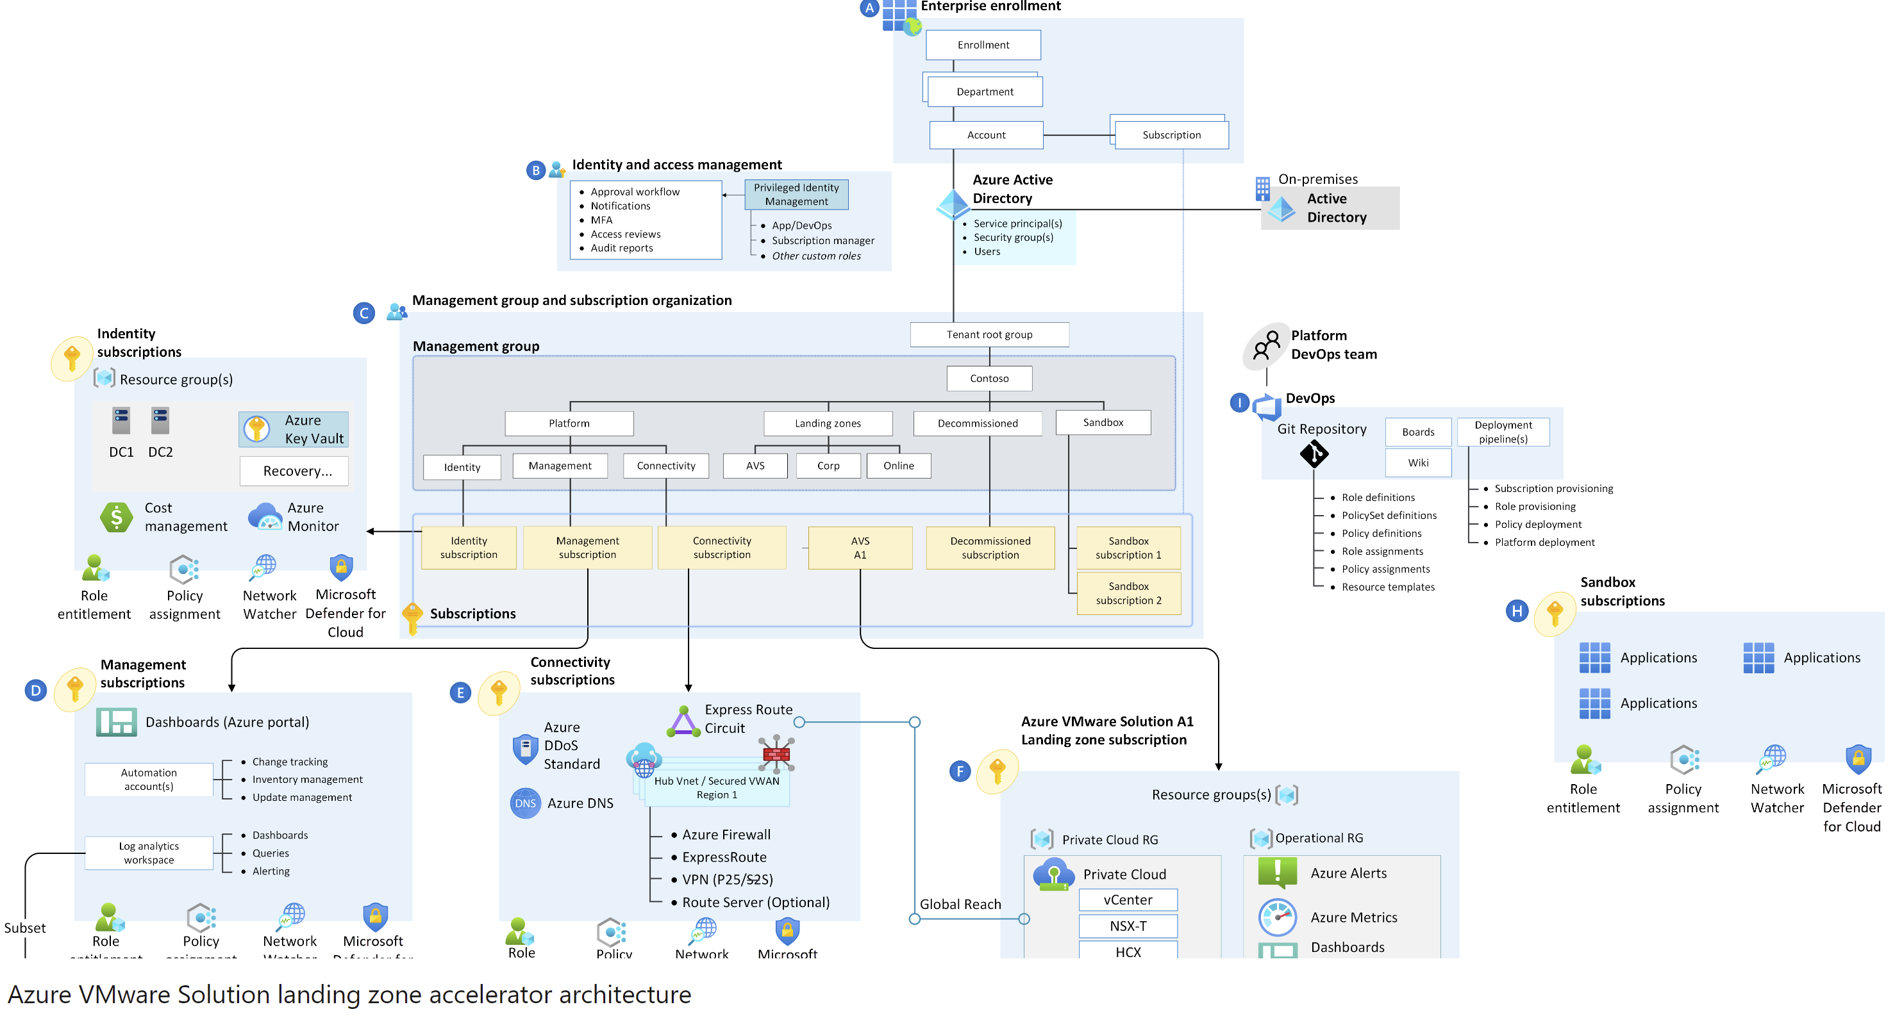
AVS Landing Zone Accelerator

Slide 16
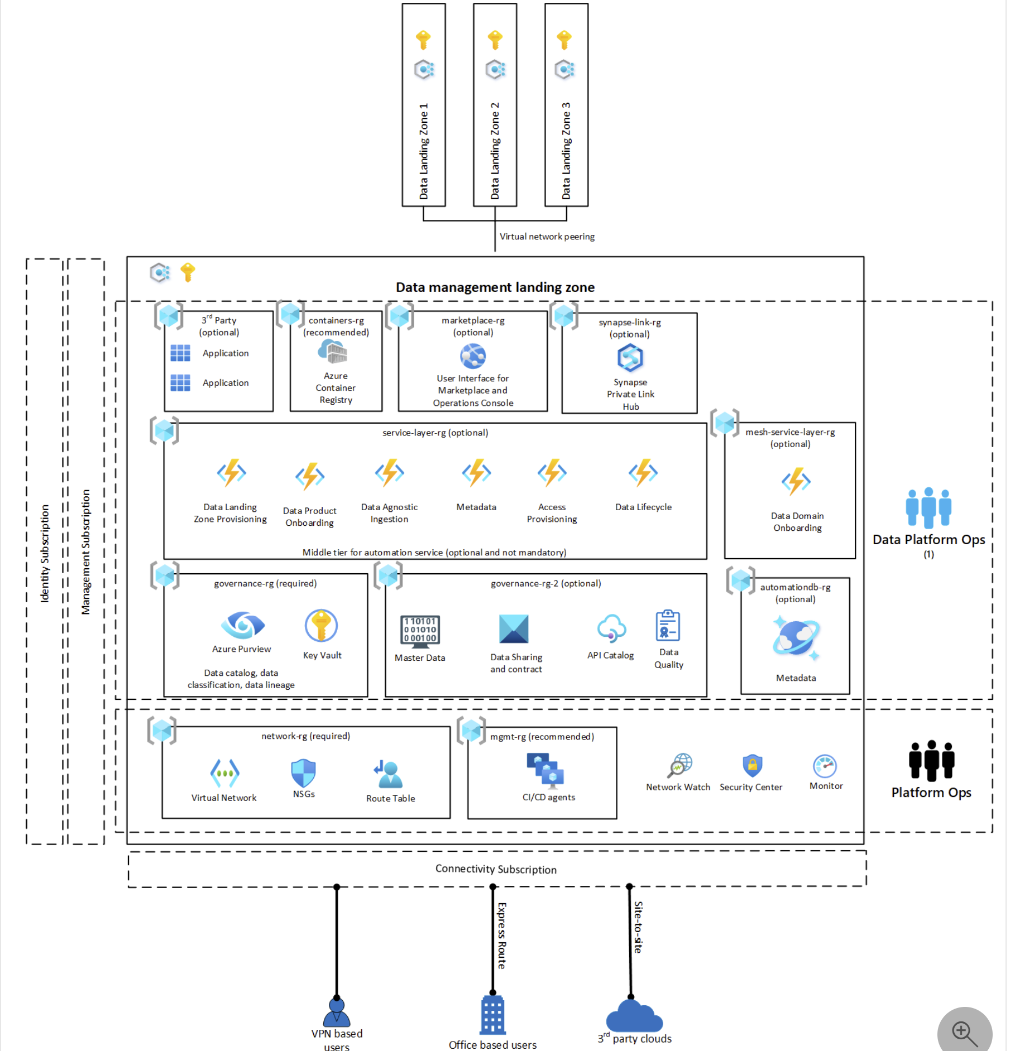
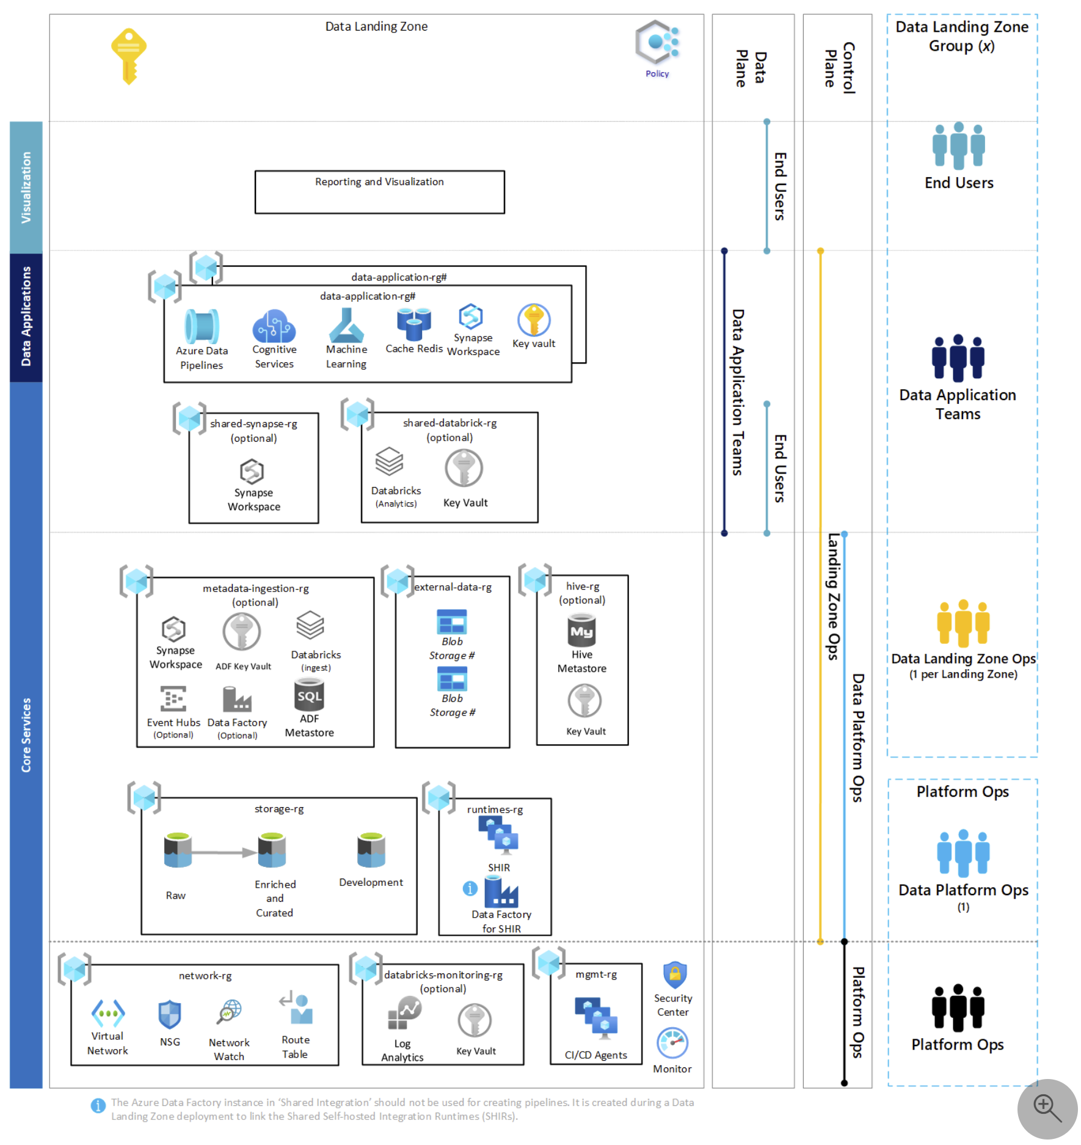
Analytics Landing Zone Accelerator

Slide 17
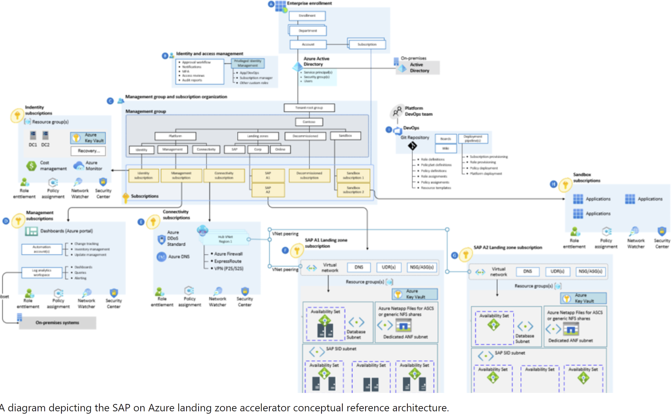
SAP on Azure Landing Zone Accelerator

Slide 18
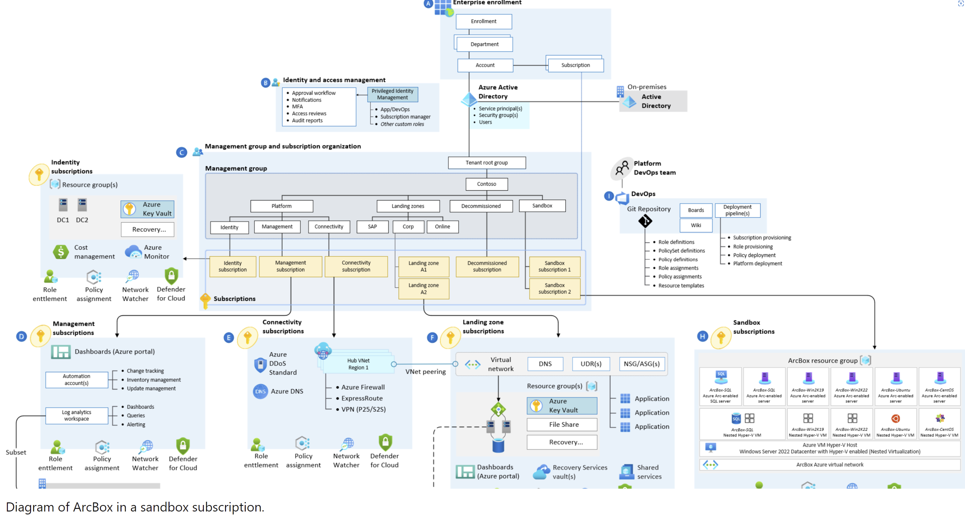
Azure Arc Sandbox Landing Zone Accelerator

Slide 19
Resources & Next Steps

Slide 20
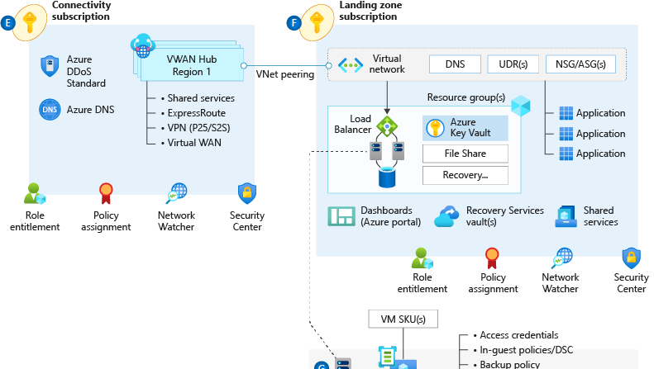
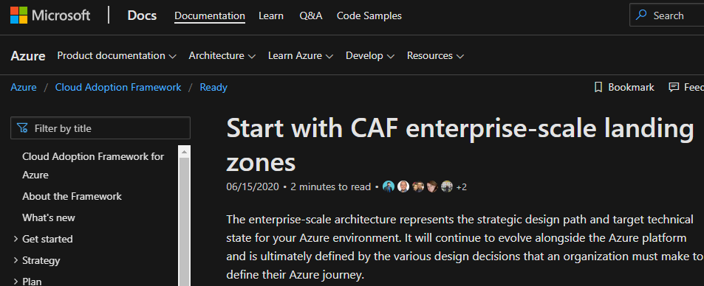
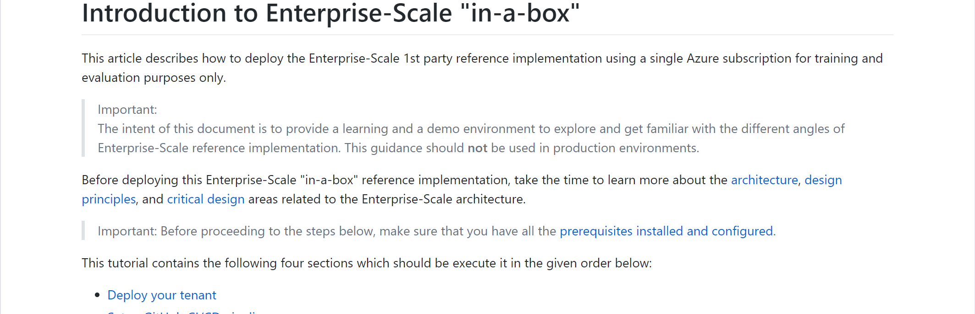
Enterprise-Scale Resources
Solution Complete 👍
Opinionated Architecture & Design Guidelines - Complete
Reference Implementation - Complete
Engineering Signoff - Complete
Enterprise-scale landing zones Architecture guidance and reference implementation:
Introduction to Enterprise-Scale “in-a-box” hands on activity
Ready overview: http://aka.ms/adopt/ready
Download a Visio file that contains Enterprise-scale architecture diagram.
Notes:
WCB Customer Engineering Team (CET)
Will maintain (build tests & track) authoritative guidance and reference implementation. Both will evolve on a regular cadence as new Azure Platform capabilities are released, & validated in production. The reference implementation will be released and updated on a best effort basis.

Slide 21
Next steps
Get ready to deploy guidance on Cloud Adoption Framework
Learn more about the Design Principles for Enterprise-scale
Drill down into the Enterprise-scale Design Guidelines to build your environment
Configure your environment using the reference implementation guide
Leverage the Enterprise-scale landing zones template schema
Let’s get started and build your enterprise-scale landing zone for successful deployment and use of Azure

Slide 22
Thank you!

